Slide 1
Pump Readiness Workshop
BCCH Diabetes Team

Slide 2
Pump Workshop Agenda
BCCH Pump Workshop Video
Deep Dive into Specifics of Health Canada Approved Pumps
Pump Side by Side Comparison
Glooko® and CareLink™
Pump Company Contact Info
Readiness Assessments
Pump Therapy Checklist
Pump Process and Next Steps

Slide 3
BCCH Diabetes Insulin Pump Program Workshop (phsa.ca)

Slide 4
Non-AID Pumps Available in Canada
Omnipod DASH®

Slide 6
Omnipod DASH®
Only tubeless pump
Need to be on 8–10 units a day minimum to use
Currently does not pair with any CGM
Tier 1 Pump – pods are covered by PharmaCare once deductible is met. Covered by many extended benefit companies
Need to carry stand alone PDM, does not connect to phone. PDM is a deactivated android phone
Minimum fill 85 units, maximum fill is 200 units
Omnipod® 5 – AID system, recently Health Canada approved

Slide 7
Non-AID Pumps Available in Canada
Omnipod DASH®
Ypsomed YpsoPump®

Slide 9
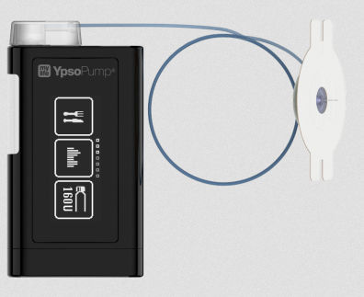
Ypsomed YpsoPump®
Can pre-fill insulin cartridges up to 30 days in advance
Maximum fill is 160 units
Tier 1 Pump – $800 starter kit may be covered by extended benefits. Infusion sets are covered by PharmaCare once deductible is met
Does not connect with any CGM yet
Has phone app to calculate insulin doses
Sales currently on hold pending release of new technology

Slide 10
Current Automated Insulin Delivery (AID) Systems in Canada
Tandem t:slim X2 with Control-IQ Technology
MiniMed™ 770G/780 with SmartGuard™ Technology

Slide 12
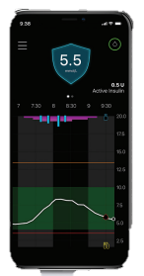
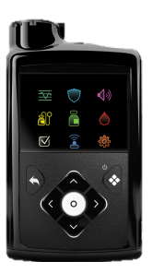
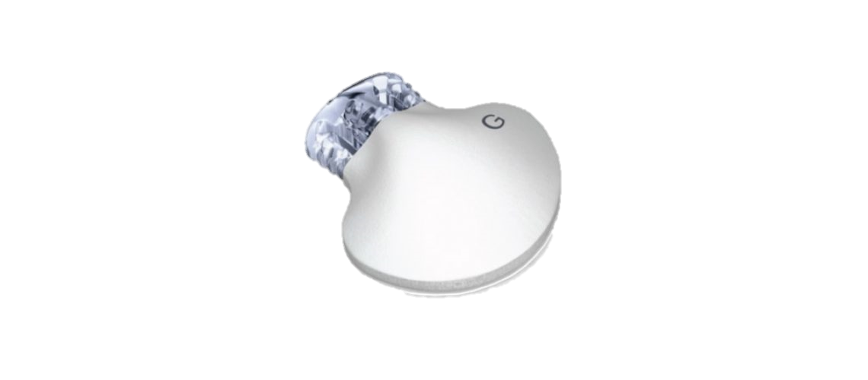
MiniMed™ 780G
Approved for ages 7+, TDD 8 units
AID System with SmartGuard™ Technology
Lets you select your glucose target (5.5, 6.1, or 6.7 mmol/L).
Can do autocorrections every 5 minutes
Modulates basal – can increase or decrease every 5 minutes based on sensor glucose reading
Works with MiniMed™ Guardian™ 3 CGM (Guardian™ 4 approved)
Has mobile app to view sensor glucose and boluses
Tier 2 pump – covered by PharmaCare once deductible has been met, covered by most extended benefit companies
MiniMed™ CGM is not covered by PharmaCare. May be covered by extended benefits, company also has payment plan options
Maximum fill is 300 units

Slide 14
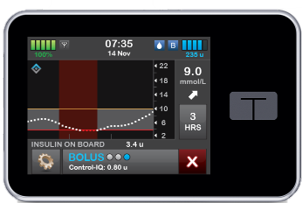
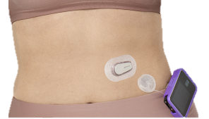
Tandem t:slim X2™
Approved for ages 6+, TDD 10 units, weight 25 kg*
AID System with Basal-IQ and Control-IQ Technology
Basal-IQ has Low Glucose Suspend vs Control-IQ with advanced hybrid closed loop technology
Can do autocorrections every once per hour
Modulates basal – can increase or decrease every 5 minutes based on sensor glucose reading
Works with Dexcom G6 CGM
Not covered by PharmaCare, may be covered by extended benefits. Tandem can contact extended benefits to determine eligibility coverage.
Minimum fill is 95 units, maximum fill is 300 units
*Discuss with diabetes team

Slide 15
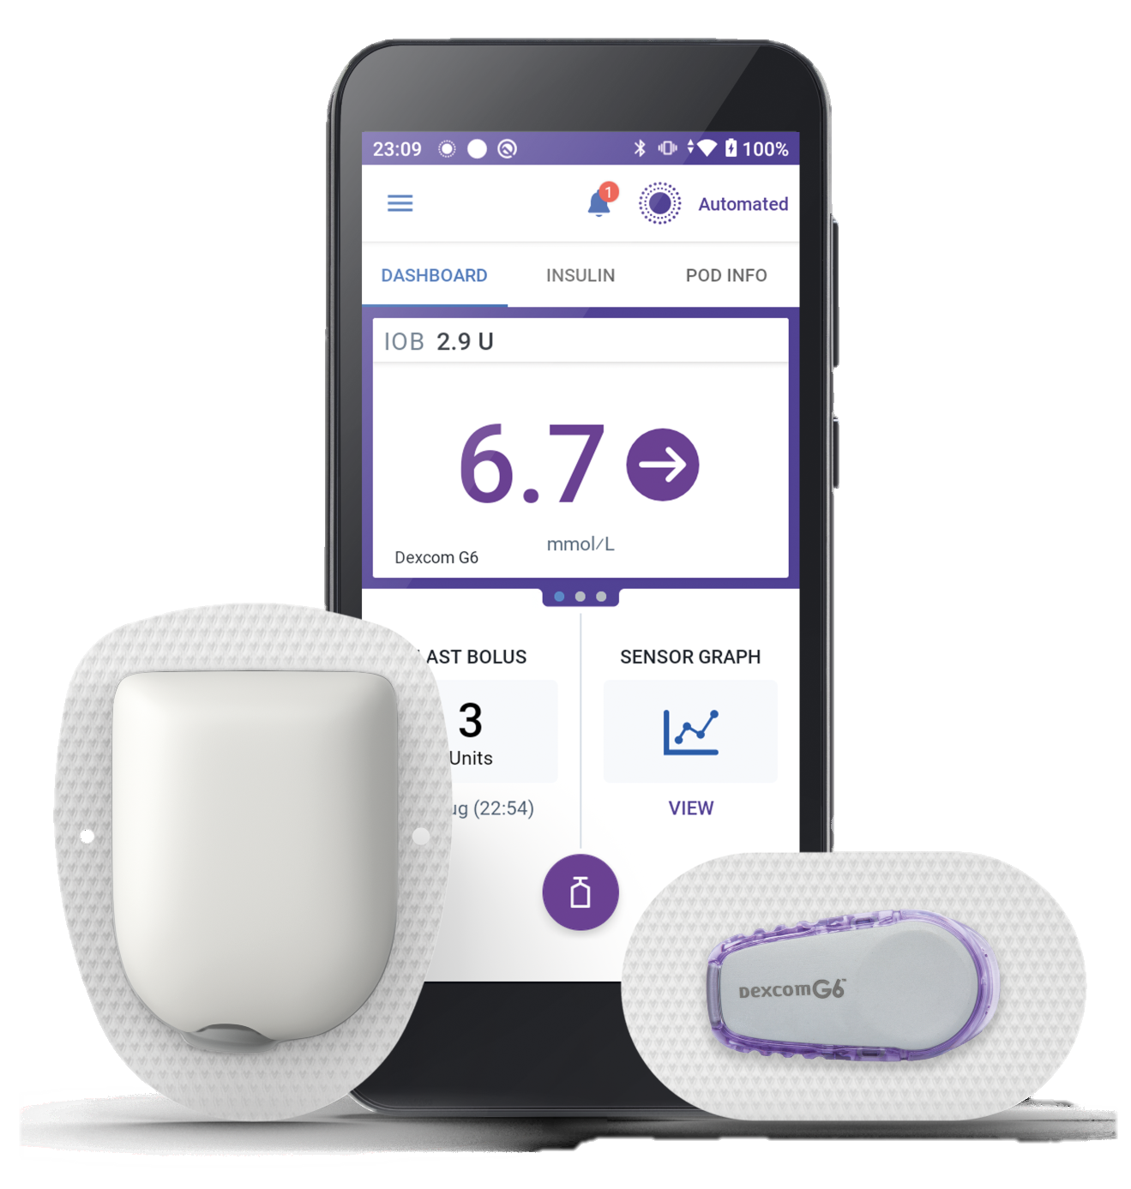
Coming Soon
Omnipod® 5
Recently approved by Health Canada
Automated insulin delivery
Works with Dexcom G6
Available ages 2+ years

Slide 16
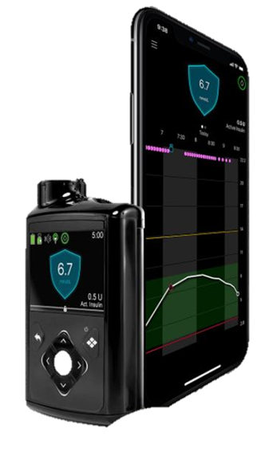
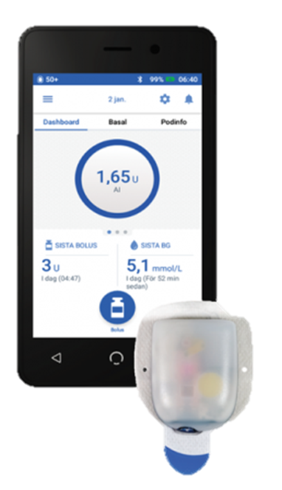
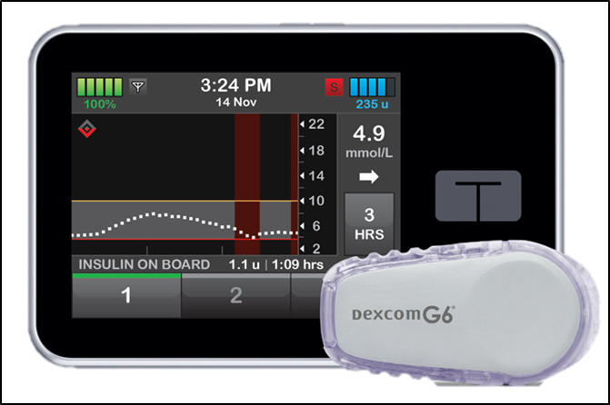
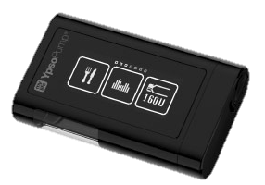
Side by Side Comparison
 | MiniMed™ 780G | Omnipod® DASH® | Tandem t:slim X2 | Ypsomed YpsoPump
CGM connectivity | Yes – Medtronic Sensor | No – can use stand alone | Yes – Dexcom (G6) | No – can use stand alone
Basal increment | 0.025 unit/hr | 0.05 unit/hr | 0.1 – can change to 0.001 | 0.05 – can adjust to 0.01
Auto basal adjustment | Yes | No | Yes | No
Reservoir size | 300 units (3 ml) | 200 units (2 ml) | 300 units (3 ml) | 160 units (1.6 ml)
Covered by PharmaCare | Yes | Yes | No | Yes
Tubing | Yes | No | Yes | Yes
Upgradeable | Yes – software update | No | Yes – software updates | No
Waterproof | Yes – IPX8 (3.6 m for 24h) | Yes – IPX8 (7.6m for 1h) | No – IPX7 (1 meter for 0.5h) | Yes – IPX8 (1m for 1h)
Good to know details | Approved for ages 7+ TDD 8 units | Approved for all ages, TDD 8-10 units | Approved for ages 6+ TDD 10 units, weight 25 kg | Need to use separate app on phone

Slide 17
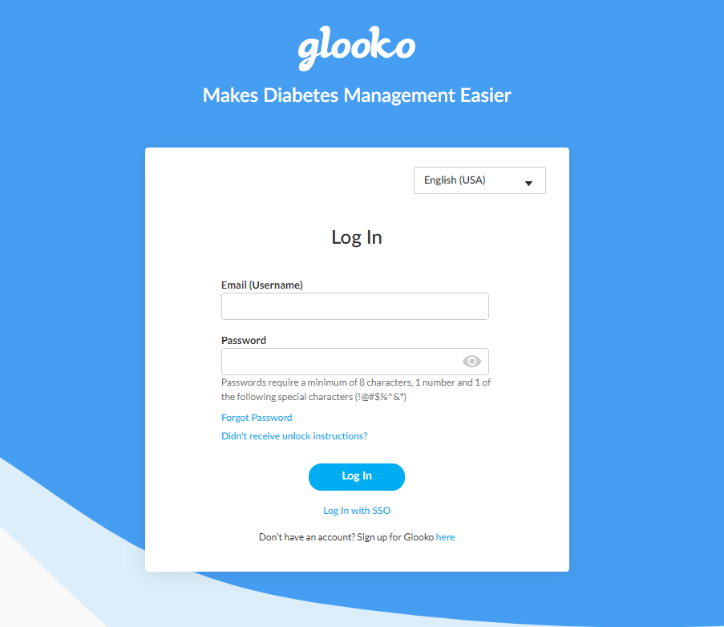
Glooko® for Omnipod® and Tandem
Logbook Web (glooko.com)
https://ca.my.glooko.com/users/sign_in

Slide 18
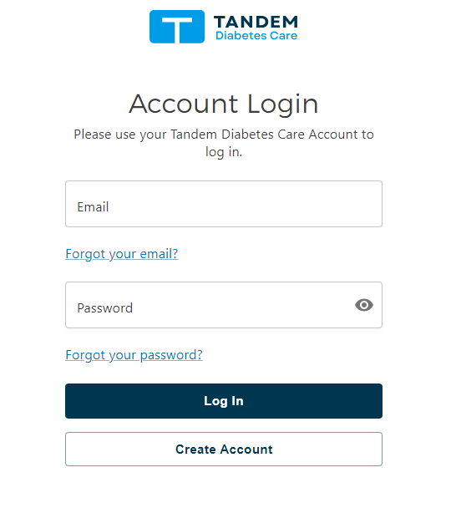
Tandem Source for Tandem
Create a Tandem Source Account – Support (tandemdiabetes.com)
https://source.tandemdiabetes.com

Slide 19
Carelink™ – for MiniMed™
CareLink™ Personal Software – For People With Diabetes (MiniMed.eu)

Slide 20
Medtronic MiniMed™ 780 G
www.medtronicdiabetes.ca
Canada: 1-800-284-4416
Sherrice Kirby: sherrice.kirby@medtronic.com
1-250-858-2329
Online virtual pump: https://eu.medtronicvirtualpump.com/fxCuA839rYX97WZH/VirtualDemoPump/MiniMed_780G_OUS/gs3/mmol_l/

Slide 21
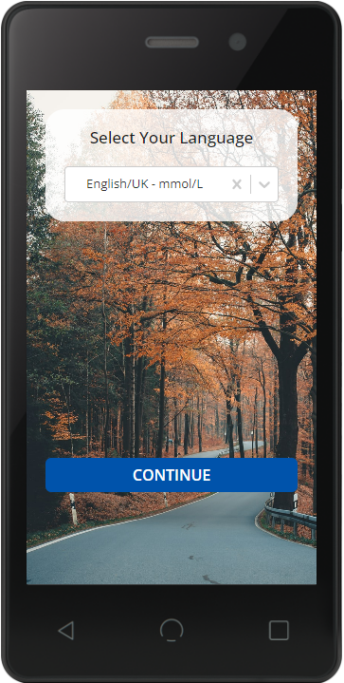
Omnipod® DASH®
Omnipod DASH® Insulin Management System (omnipod-staging.netlify.app)
https://www.omnipod.com/en-ca/home
Canada toll-free number: 1-855-763-4636
Cyndi Lund: clund@insulet.ca
1-250-938-5825

Slide 22
Tandem t:slim X2
https://www.tandemdiabetes.com/
Canada: 1-833-509-3598
Teri Currie: tcurrie@tandemdiabetes.com
778-995-1268
T:simulator app available from the Apple store and Android Play

Slide 23
Pump Readiness & Carb Counting Assessments
http://www.bcchildrens.ca/endocrinology-diabetes-site/documents/pumpreadinessfill.pdf
http://www.bcchildrens.ca/endocrinology-diabetes-site/documents/carbquizfill.pdf

Slide 24
Checklist for Pump Therapy
You have a computer (or access to one) to upload the pump at least 3 times a week when initially starting the pump
You agree to accept the BCCH clinic request to share your pump data so that we can safely manage your child’s diabetes
Caregivers are required to attend the initial pump training session together. We are unable to offer separate training sessions
Continue to upload the pump regularly at home to review and make any dose adjustments as needed
Upload the pump at home before your diabetes clinic appointment
Child and all caregivers are interested. This includes younger children who understand that they will be wearing the device on their body
You have attended the Pump Readiness Workshop and completed the Pump Readiness and Carb Counting Assessment
For younger children, parents are aware that daycare staff may not be able to operate the pump. This needs to be discussed directly with the school and daycare
You are able to make insulin dose adjustments as needed
You rotate injection sites to include a minimum of 2 different parts of your body

Slide 25
Process
Readiness assessment
Readiness assessments will be sent –complete both assessments.
pump video and readiness workshop
Readiness
Assessments will be reviewed by team. If there is anything that needs further review or follow up, the diabetes team will reach out.
CONTACT COMPANIES
Contact companies for information and to determine coverage.
Complete forms as required
and send to clinic
Pump Waitlist
Family will be placed on pump
training waitlist.

Slide 26
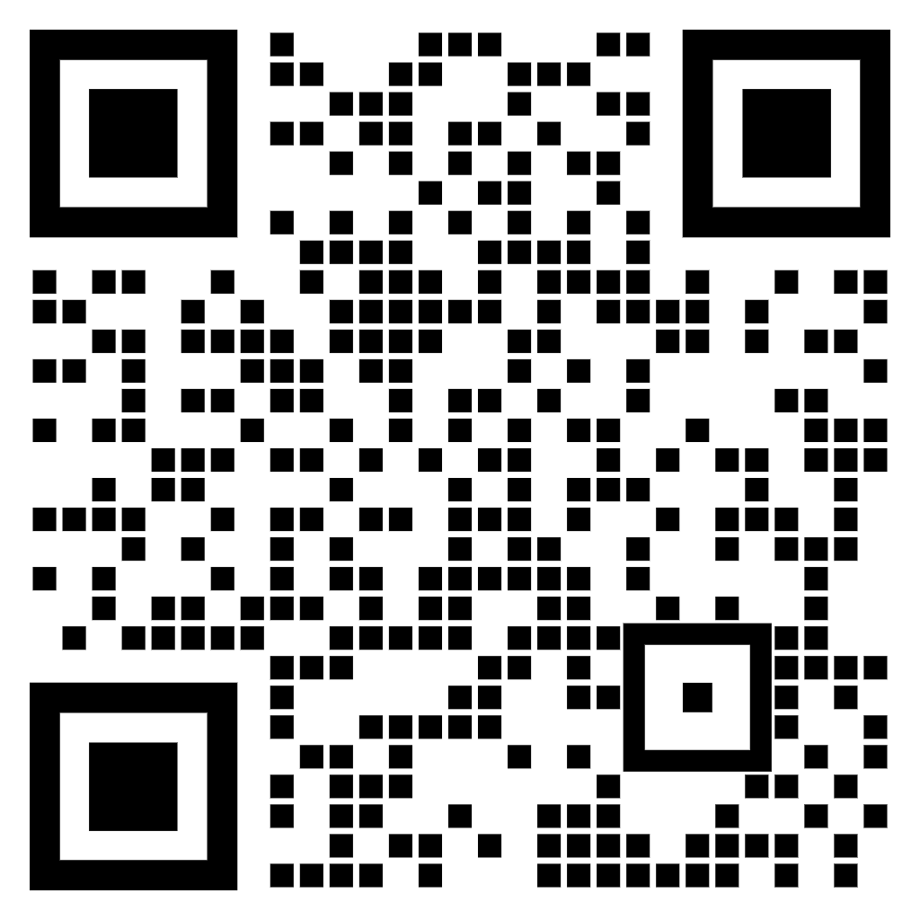
Ready to Go?
Scan this QR code to send the BCCH Insulin Pump Nurses an email to let them know that you have:
viewed the PowerPoint workshop and videos
completed and returned the Pump Readiness and Carb Counting assessments
contacted the pump company rep
discussed insurance coverage with company
decided on a brand of pump
… and are ready to move forward with pump therapy for your child.

Slide 27
Thank You!
Any Questions?

